Slide 1


In Zukunft Leben
29.10.2014

Slide 2

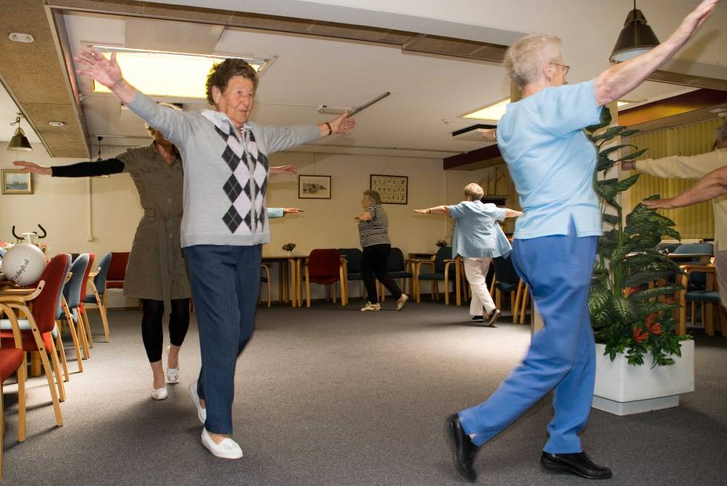
Agenda
Healthy Ageing
Healthy Ageing Europe and the Northern Netherlands
Future of Health Care
Programme Healthy Ageing Hanze UAS
Centre of Expertise Healthy Ageing
Prepare for health care in the future

Slide 3
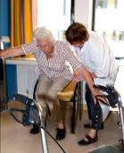

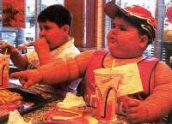
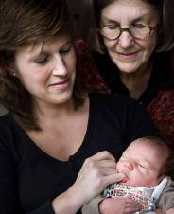

Healthy Ageing: Longer healthy
Societal
benefit
Ambition
Health
Prevention
Interventions
worst case scenario
From young to old age
Age
Notes:
3

Slide 4
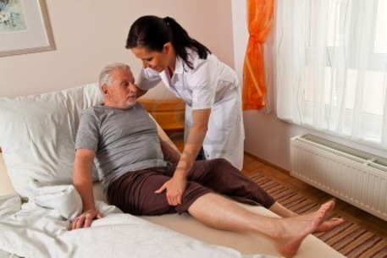
A number of facts
The Netherlands
Population of 65+ increases from 2,6 million (2011) to 4,6 million (2040)
Costs for health care for the elderly increase with 2,5% per year
Demand for health care personnel increases with 1,4% per year
Supply of personnel decreases with 0,2% per year
Over a period of 29 years 75% of the care supplied by nursing practitioners is for patients of 65 +
Professionals prepare for the upcoming changes
The future of health care

Slide 5
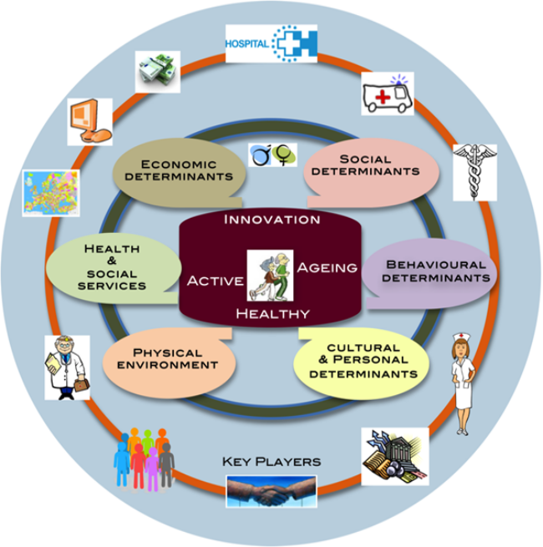
Challenges
Demographic changes touch socially and economically for example on:
Pensions
Labour market
Health care
Living environment/Housing
Healthy ageing
That is why high on European agenda

Slide 6
Active & Healthy Ageing in Europe
Definition WHO (2002)
Active & Healthy Ageing is:
The process of optimizing opportunities for health, participation and security in order to enhance quality of life as people age.
Active ageing applies to both individuals and population groups.
It allows people to realize their potential for physical, social and mental well-being throughout their lives and to participate in society according to their needs, desires and capacities,
while providing them with adequate protection, security and care when they require assistance (WHO 2002)

Slide 7
Centre of Expertise Healthy Ageing
We started writing the Businessplan in January 2013
Applicant: Hanze UAS
Partners: from 35 to 140 partners
Scale: 16 million Euro in total in 4 years
Functions: research, innovation of practice, innovation of education, business development with eg SME (small and medium sized enterprises)
Form: regional living labs

Slide 8
Innovation labs
Form Triple helix (institutes for care and wellbeing, businesses, knowledge institutes)
Aim Realising innovative solutions (products, services) to practise-based questions in care and well-being
Cooperation Educational institutions, institutions for health care and wellbeing, businesses, regional and local authorities, researchers, lecturers and students
Realisation Spring 2014: 23 innovation labs
Themes: 1. Active Life Style & Sports, 2. eHealth & Technology, 3. Healthy Food, 4. Youth & Life Style, 5. Living, Leisure & Care, 6. Healthy Ageing at Work, 7. Wellbeing & Care
Output New products and services
At the end of 2014: about 25 innovation labs

Slide 9
Themes and funtions CoE
Themes: innovation of Care and Wellbeing
- Prevention; Citizens; Participation
- Exercise and Nutrition; Housing & Labour
- Technology & ICT (eHealth)
- Cost reduction health care
- Role professionals
Functions:
- Applied research/Practice-oriented innovation
- Education development/Business development
- Information/PR/Communication

Slide 10
Partners CoE HA
4 Northern Universities of Applied Sciences
5 Regional Educational Centres
UMCG, University of Groningen
Care and Wellbeing: more than 50 partners
Businesses: more than 50 partners
Authorities: 7 local, 2 regional
Further: HANNN, ZorgInnovatieForum (network organizations)

Slide 11
Results CoE HA after 1.5 year
Over 7 million € on innovation programmes started
Growth from 35 to 140 partners
118 partners active in 23 innovation labs
Growth to 25 innovation labs at the end of 2014
Over 160 students from VET and higher education involved
21 research programmes, 71 research projects
11 innovative products and services
New educational programmes in higher professional education and VET
12 new companies on healthy ageing

Slide 12
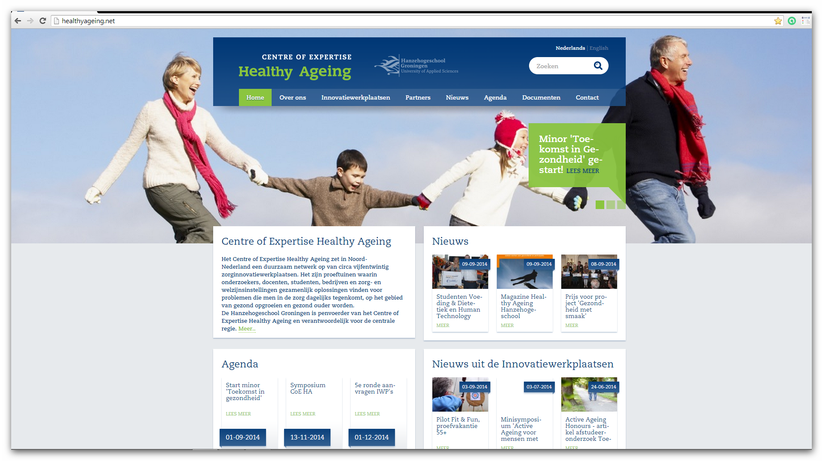
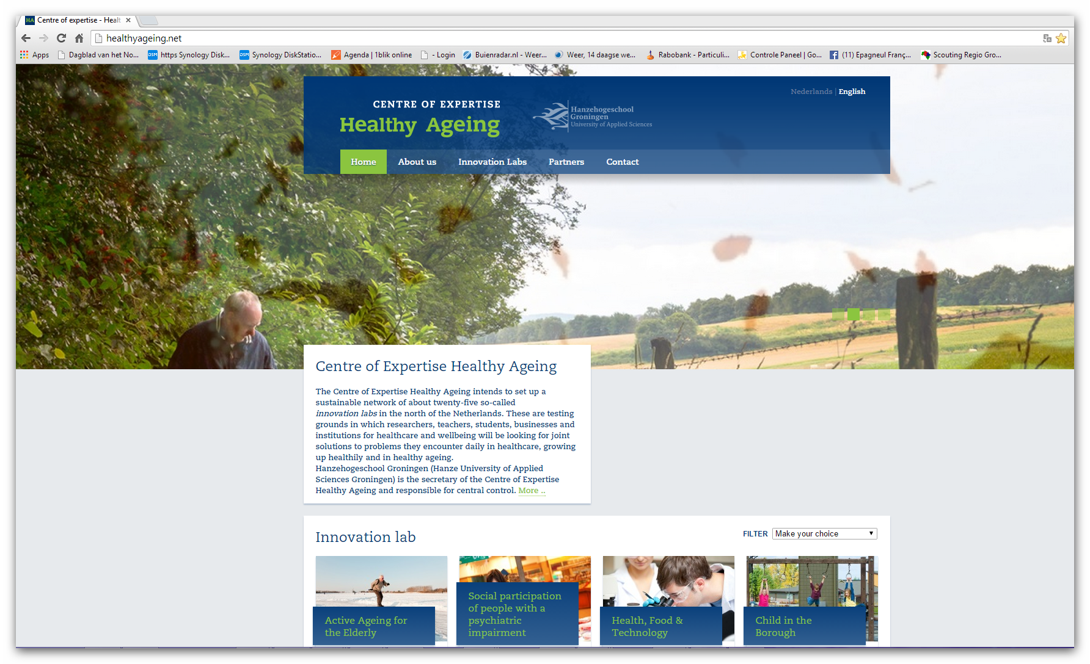
Een aantal feiten
22-10-2014 Kenniswerkplaats Noordoost Fryslân

Slide 13
Example: Innovation labs Active Life Style & Sports
Active Ageing for the Elderly
Initiator Hanze UAS; partners eg ZuidOostZorg, VitalinQ and Sense. Aim: Keep older people healthy for as long as possible with the aid of prevention and increasing their social and work participation, for example life style programmes, apps, refresher courses for professionals
Active Ageing for People with a Mental Impairment
Initiator prof. Aly Waninge Centre of Expertise HA; partners eg De Zijlen, Visio, VitalinQ and Sense. Aim: Keep people with a mental impairment physically healthy for as long as possible with the aid of prevention and increasing their social and work participation, for example life style programmes, apps, refresher courses for professionals
Active Ageing Diabetes
Initiator dr. Martijn de Groot Centre of Expertise HA; partners eg Bethesda Diabetes Research Centre, companies. Aim: Keep people with diabetes as healthy as possible for as long as possible with the aid of prevention and increasing their social and work participation, for example life style programmes, apps, refresher courses for professionals
Sports and Healthy Ageing
Initiator: UMC and University Groningen (Human Movement Sciences), partners: Lode, HG
Aim: multi-disciplinary prevention and medical supervision of the (injured) athlete

Slide 14
Example: Innovation labs eHealth & Technology
eHealth / Serious Gaming:
Initiator prof. Ate Dijkstra NHL; partners eg Noorderbreedte, VET, Lable Care, Grendel Games, Limis.
Aim: Making it possible for older people to stay in their own homes for longer by means of serious games, e-learning, eHealth coaching; through practice based research, educational innovation, business development.
Exergaming for Children with Motorial Impairments
Initiator dr. Ant Lettinga UMCG/Department of Rehabilitation; partners eg Hanze UAS, NHL, CGI, KPN, Ordina.
Aim: By using exergaming and modern media in the rehabilitation of children with a motorial impairment organising and evaluating their own home environment in a smarter and more efficient way

Slide 15
Example: Innovation Labs Healthy Food
Health, Food & Technology
Initiator prof. Feike v.d. Leij VHL; partners eg NHL, VET, food companies Telson, Koopmans.
Aim: innovations in the field of healthy food (new sources of fibres from residual waste of shrimps and new applications of proteins from dairy products: slow carb and high protein).
Clinical Malnutrition
Initiator prof. Harriët Jager UMCG; partners eg Hanze UAS, VET, Friesland Campina, Ordina. Aim: To increase the knowledge concerning diet and exercise for patients who are in danger of malnutrition.

Slide 16
Example Innovation Labs Wellbeing & Care
Social participation of people with a psychiatric impairment
Initiator GGZ Friesland; partners eg Hanze UAS, NHL, RGOc/UMCG, Timpaan, municipality of Leeuwarden. Aim: Combining practice based scientific research with the implementation of new interventions and the training of professionals, so that more insight will be gained into the success factors and the impediments the target group experiences when it starts to participate in society as a result of reallocation of functions from the Dutch Association of Mental Health and Addiction Care to the local authorities.
Wellfare and Health Care Elderly People: Innovation through Learning
Initiator prof. Evelyn Finnema NHL; partners eg ZuidOostZorg, VET, Hanze UAS
Aim: To set up a learning community by means of co-makership.
Introduction of Social District Teams in the Municipality of Emmen
  Initiators Sedna (Tinten) and Promens Care; Partners eg Municipality of Emmen, institutions for care and wellbeing, Hanze UAS
  Aim: To develop a managerial and support model which does justice to the multi-level question within the dynamics of the social domain.

Slide 17
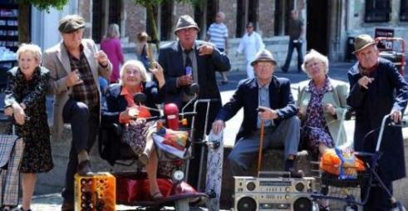

Healthy Ageing: your/our future
http://www.youtube.com/watch?v=LL-TJjCJPaI
Prepare for a working life with an ageing population
Other ways of working:
  Innovative
  More technology/telehealth
  Multidisciplinary
  More grouplike, exercise programmes
  Role in prevention and care independency

Slide 18


For more information and/or questions
www.healthyageing.net
Manager Business Development Peter Boonstra
p.h.boonstra@pl.hanze.nl

